Slide 1

CompSci 2SD3
Tutorial #2
TA: Jatin Chowdhary
DATE: February 1st, 2022

Slide 2
Announcements (1)
Starting February 7th, 2022, we will be going 100% in-person for lectures/labs/tutorials/etc.
  However, everything* will be recorded so don’t feel pressured to come in-person (and risk yourself plus the people around you)
    *[(Every tutorial run by me will be recorded)]
Assignment #1 is due next week; February 9th, 2022
  Including today, you have 8 days
    However, you (my students) should finish by Friday
The other TAs have code in their slides
  Avoid using this unless you are stuck
    It is a great resource, but don’t lean on it too much

Slide 3
Announcements (2)
The other TAs have code in their slides
  Avoid using this unless you are stuck
    Some of you are probably already aware of this
Do the assignment legitimately
  Get good at C
    C is the greatest programming language
  Unlike your other courses, the stuff you will learn here is relevant
Don’t even take a ‘‘quick’’ peak at the other slides
  There is no such thing as ‘‘I’m just gonna eat one (potato) chip’’
    If you open the bag, you’re gonna finish the (entire) bag

Slide 4
Any Questions?

Slide 5
Itinerary
Announcements
Assignment #1 Review/Walkthrough
  Where to find it?
  How to get it via 2SD3fetch?
  What to do?
  How to submit via 2SD3submit?
  Corrections and clarifications
  Questions
  Correlation description with TODO

Slide 6
Getting Started
Everything is on the course website
  1. Login with your student number and password
  2. Click on ‘‘Assignments+Tests’’
  3. Select ‘‘Assignment 1’’
Basic rules:
  Using code you found on the Internet (i.e. Stackoverflow) is fine, but make sure you cite it
    i.e. ‘‘I got this snippet of code from abc-tutorials.com’’
  Avoid discussing/reviewing the assignment with each other
    Try to be legit – being able to program gets you into FAANG

Slide 7
Other Stuff
If you’re unable to submit after the deadline (i.e. Emergency, Issues, etc.), send an email to Dr. Franek (franek@mcmaster.ca), with all the files related to the submission.
  Include relevant information like:
    Reason (i.e. Emergency, Issues, Etc.)
    Course code
    Full name
    Student number

Slide 8
Fetch The Assignment
Create a fetch script
  Instructions are on the website
    But I’ll go over it for fun
      i.e. 2SD3fetch
Note:
  To execute the script, after giving it write permissions (i.e. chmod u+x), type the following: ./2sd3fetch
    Side note: Type chmod u+x 2sd3fetch to make the file an executable
  You must fetch one file at a time

Slide 9
The Files
After fetching, you should have the following:
  log.h
  log.c
  job.c
  assgn1_skel.c
  makefile
Note:
  The only file you need to modify is assgn1_skel.c
    You can modify the makefile (i.e. Add ‘‘make clean’’)
    Do not modify the other files; reading them is fine
  Make sure you rename assgn1_skel.c to assgn1.c
    If you forget to do this, the makefile won’t work

Slide 10
Submission (1)
Let’s make a quick edit (i.e. Print something) and submit the assignment
  Add printf(‘‘Submission test’’); to the top of the main() function
    Not literally on top, but the first line after: main(…) {
Note:
  Always compile your program to make sure it works
    Broken/buggy code will be heavily penalized

Slide 11
Submission (2)
Create the submission script
  Instructions are on the course website
    But I’ll go over it
      i.e. 2SD3submit
The only file you need to submit is:
  assgn1.c // This is the file you make amendments to; the C source file
Note:
  Don’t forget to add ./ in front of 2SD3submit
    Similar to 2SD3fetch
  Always verify your submission on the course website
    Login to the course website and double check that your latest submission is there
      View the contents of the file to make sure you submitted the correct file
    Do not solely rely on the script

Slide 12
Any Questions?

Slide 13
Purpose
What’s the purpose of assignment #1?
  I’ve been asked this quite a few times
What are we even doing?
  To create a simple job dispatcher
    Another program (i.e. job.c) will create jobs, and your program will dispatch the jobs based on some criteria
What is the point of this?
  Next slide
What is the merit behind this?
  Next slide

Slide 14
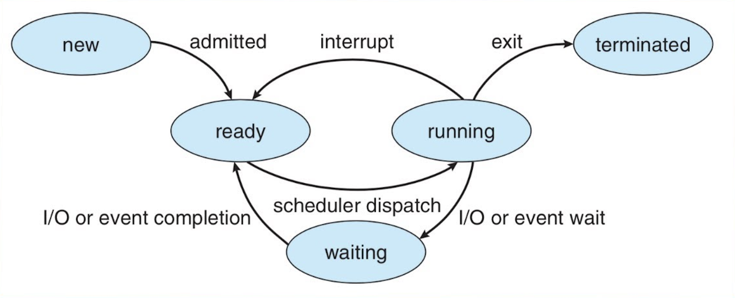
Processes (1)
Recall from 2GA3: Operating systems have scheduling algorithms and dispatchers to give processes CPU time

Slide 15
Processes (2)
Essentially, what you are doing is creating a job dispatcher/scheduler
  The purpose of the job dispatcher is to decide which process gets resources (i.e. CPU time)
The jobs are created by another program (i.e. jobs.c), and your program will decide which job gets priority (i.e. CPU time)
  Signals are used to ‘‘start’’ jobs and ‘‘remove jobs from processing’’
    Note: Your program doesn’t literally do anything mentioned above. Rather it simulates it (i.e. Pretend)

Slide 16
Now, Let’s Start Coding

Slide 17
Coding (1)
Before you start, read the description for Assignment #1
  Should I review it right now?
Anytime you see ‘‘TODO’’ and ‘‘END TODO’’, you need to:
  Read the description of what needs to be done
  Implement/code it right after ‘‘END TODO’’
  Walkthrough: Checking arguments in `` main() ``
Recall that assgn1.c is the only file that needs to be modified
  In other words, only assgn1.c has TODOs

Slide 18
Coding (2)
Note:
  The ‘‘new’’ file I’ve provided does not give you any extra code
    Rather, it explains in more detail what needs to be done
      Everything has been outlined in a step-by-step fashion
    Better correlation with the description on the course website
Additional information on how to implement the require data structures are on the course website
  Recall that you can use some code off the Internet, as long as you clearly state where you got it from
    This will be useful for the Queue data structure

Slide 19
Description (1)

Slide 20
THE
END

